Slide 1

Chapter 1 Math Prelims and Floating-Point Representation
Introduction

Slide 2
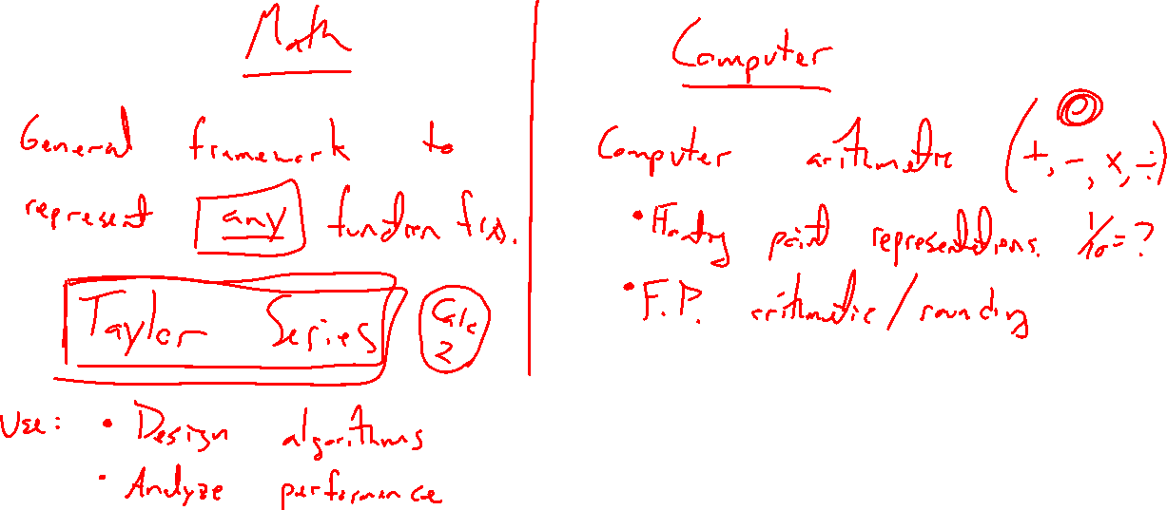
Two foundations
Notes:
2 foundations to build
- Math: Many methods we dev use functions. How to approach all functions in general? Taylor series.
- Computer: How are numbers represented? What are the limitations?

Slide 3
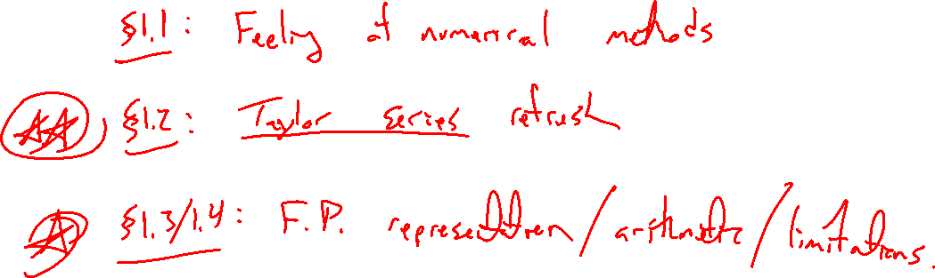
Outline of Chapter
Notes:
A feel for NMs
Taylor series from scratch
Feel for computer numbers / arithmetic and limitations

